Slide 1


Fundamentals of computer vision
Artemiy Firsov

Slide 2
General information
36 academical hours of lectures and seminars
72 academical hours of home work (faster – better for you☺)
Attendance + home tasks affect the final grade
Materials - https://github.com/ArtemiyFirsov/nsu-computer-vision
Intro test https://forms.gle/CqLzoudhmB6yx8hR8 - must be done
Questions – Telegram
My Pocket account – many useful links
Some useful links

Slide 3

What is cv?
Visual perception is the ability to interpret the surrounding environment using light in the visible spectrum reflected by the objects in the environment.
Computer vision is an interdisciplinary field that deals with how computers can be made for gaining high-level understanding from digital images or videos. From the perspective of engineering, it seeks to automate tasks that the human visual system can do

Slide 4


problems
Digits recognition

Slide 5
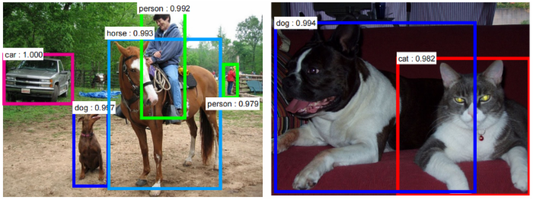
problems
Digits recognition
Object detection

Slide 6
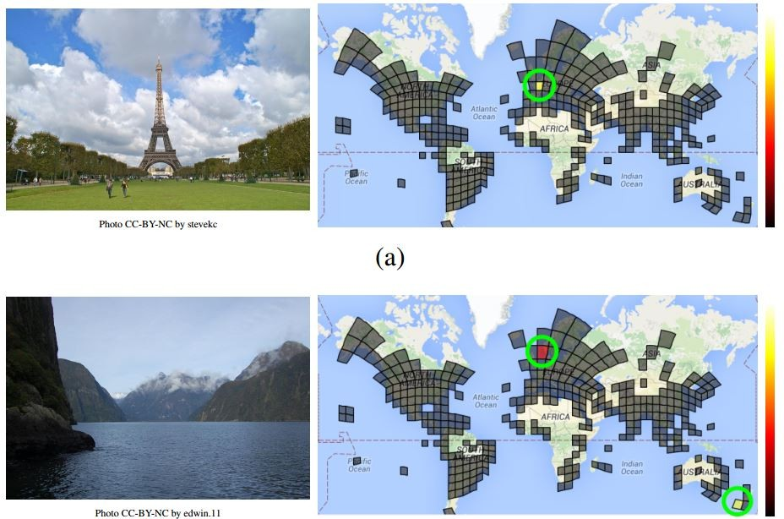
problems
Digits recognition
Object detection
Places recognition

Slide 7
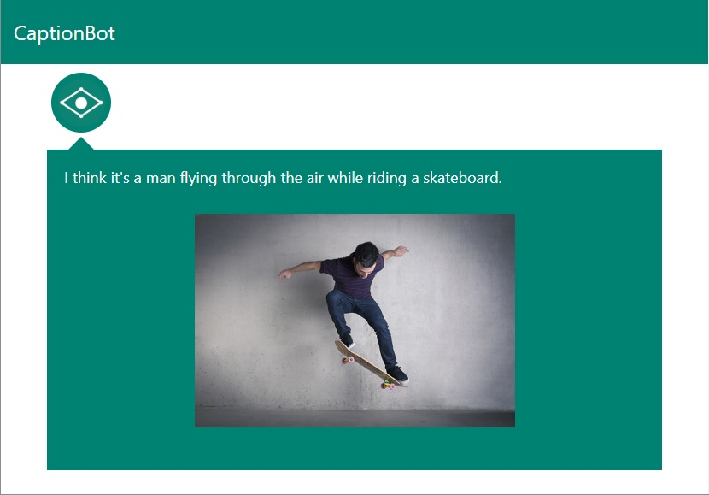
problems
Digits recognition
Object detection
Places recognition
Properties recognition

Slide 8
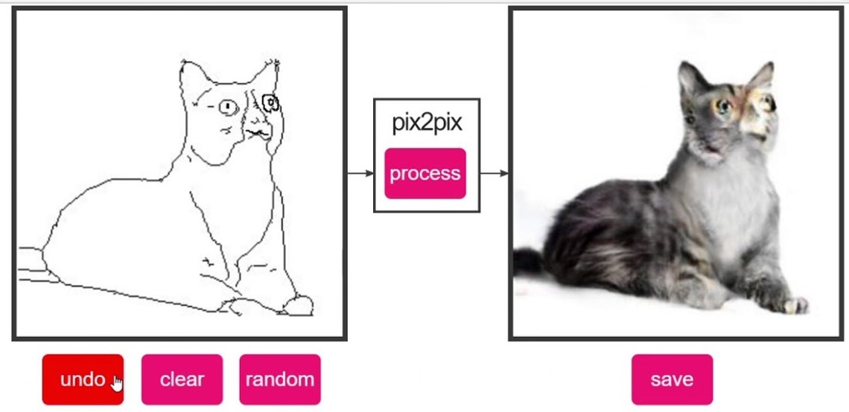
problems
Digits recognition
Object detection
Places recognition
Properties recognition
Creating new images

Slide 9
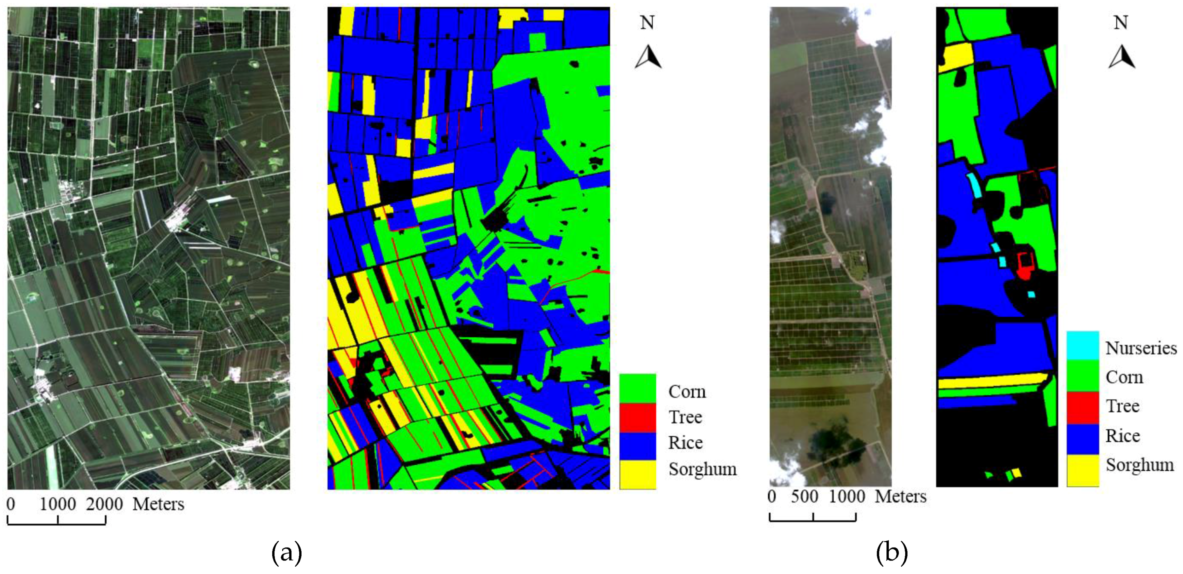
problems
Digits recognition
Object detection
Places recognition
Properties recognition
Creating new images
Shape and distances detection

Slide 10
History of optical instruments

Slide 11
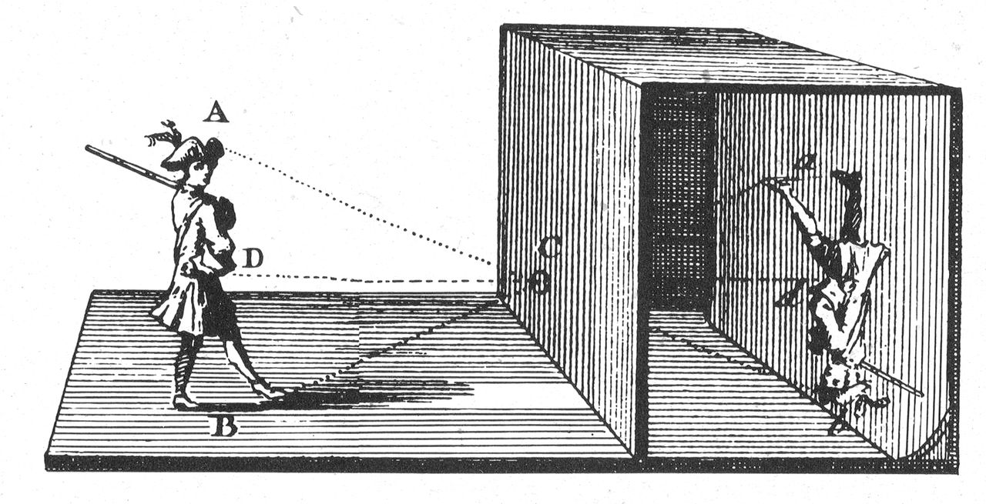
Pinhole camera (camera obscura), 5-6 BC

Slide 12
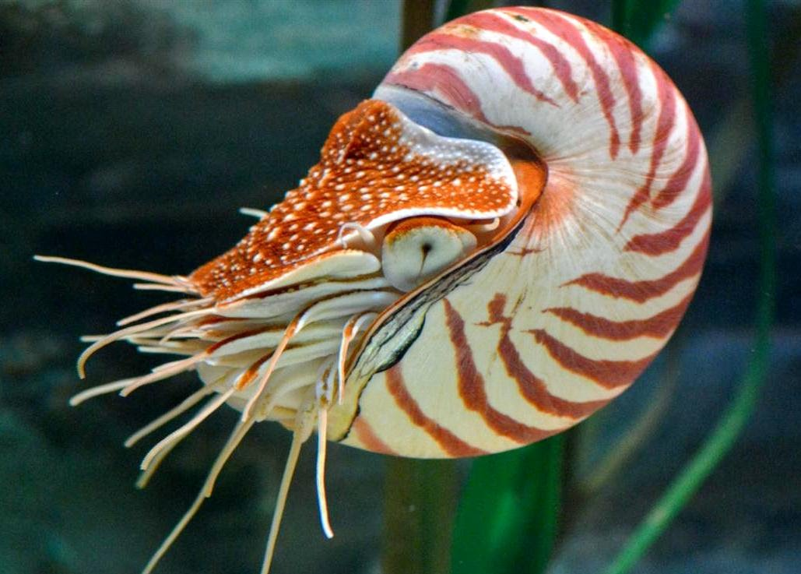
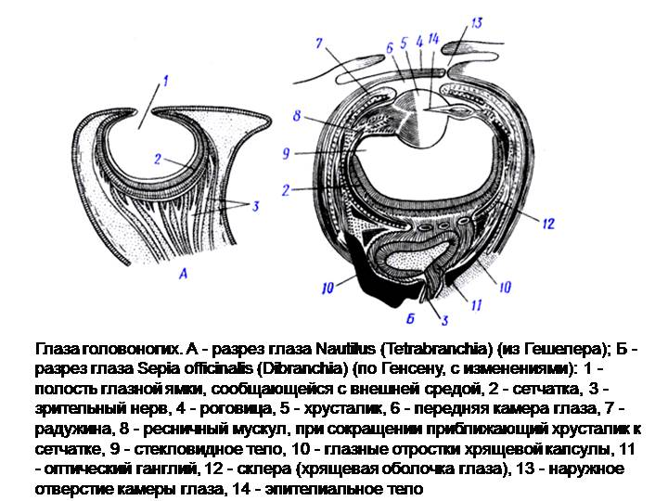
nautilus pompilius

Slide 13
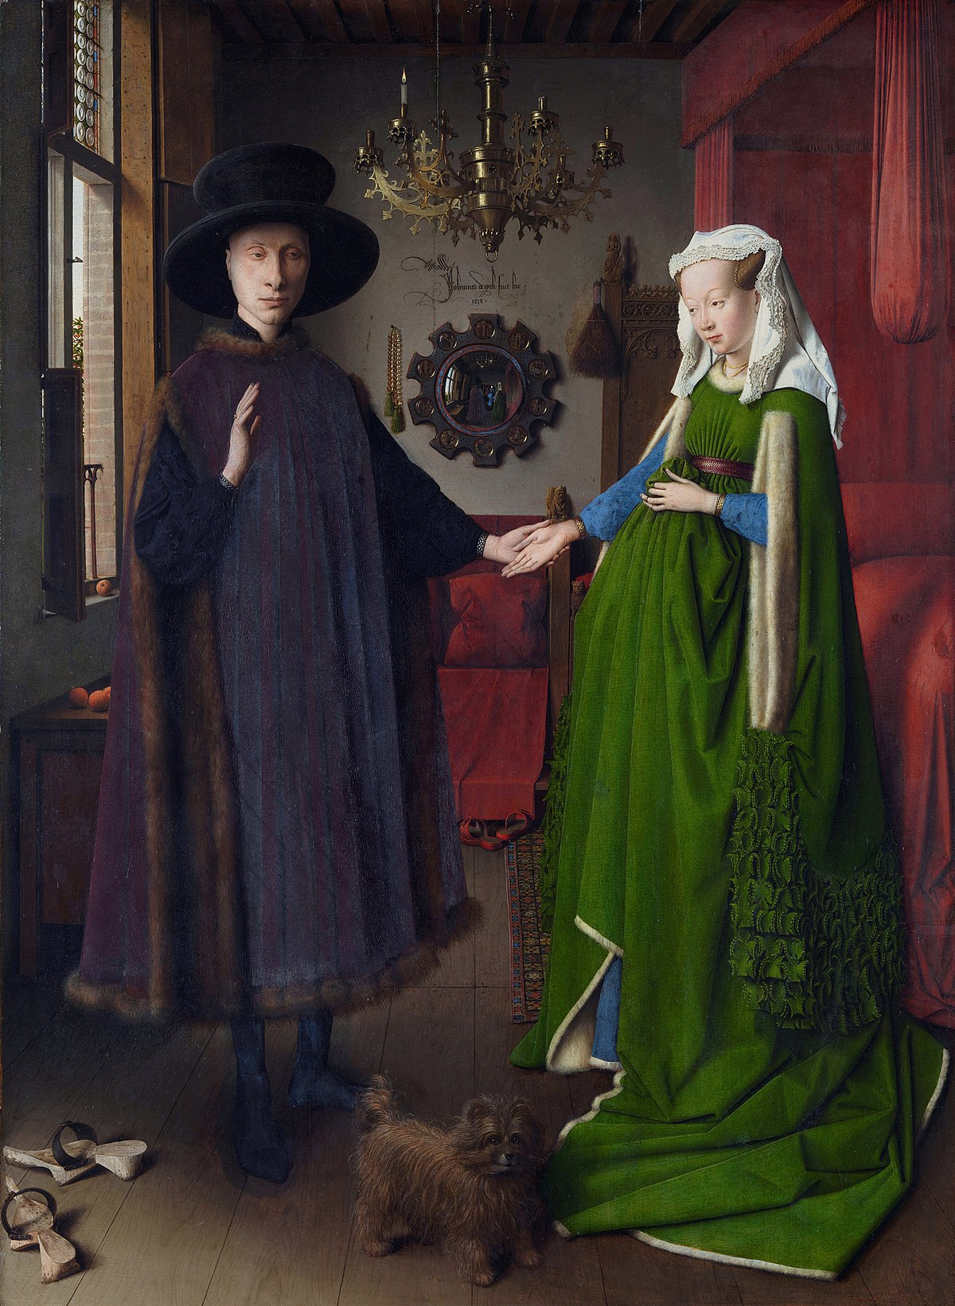
Van eyck, 1434

Slide 14
Van eyck, 1434

Slide 15
Van eyck, 1434

Slide 16
How he did that?

Slide 17
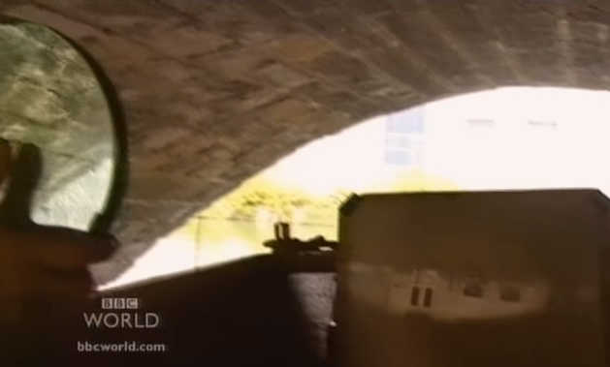
It was just a mirror )))
BBC David Hockneys Secret Knowledge

Slide 18
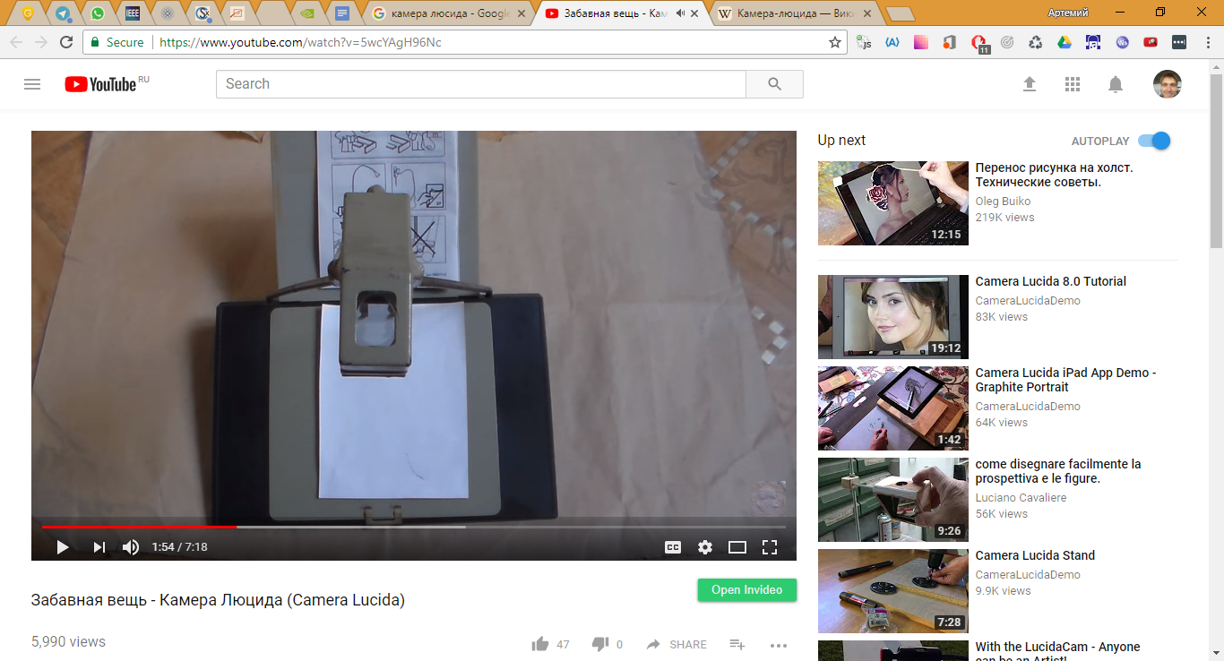
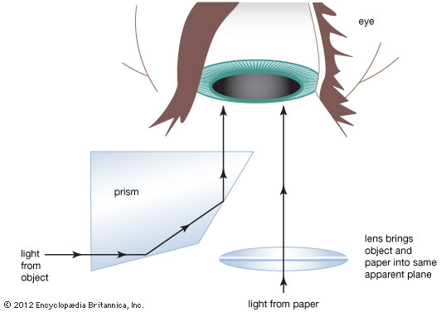
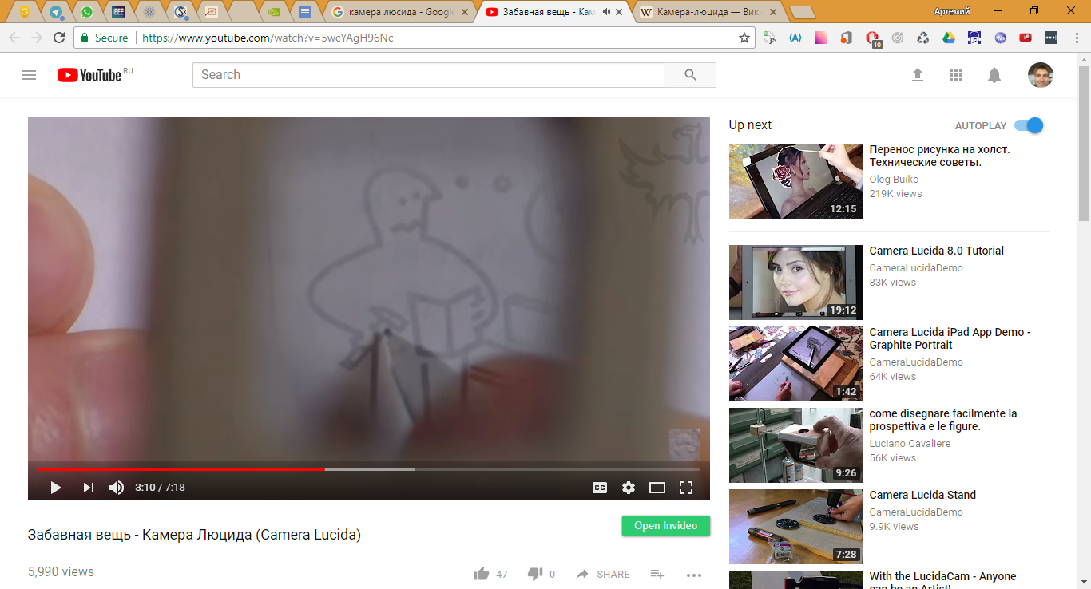
Camera lucida
https://www.youtube.com/watch?v=5wcYAgH96Nc

Slide 19
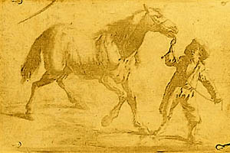
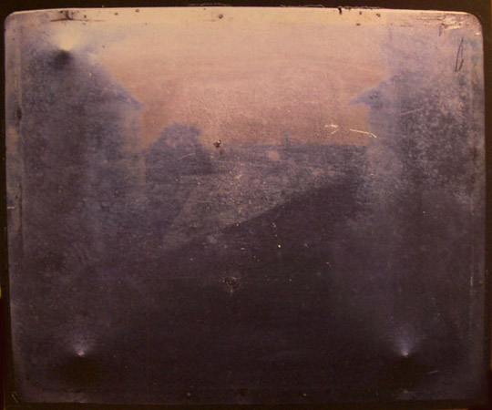
First photo, 1825, 1826

Slide 20
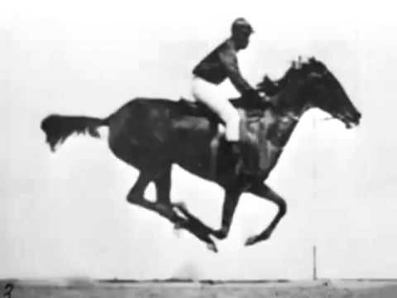
first «video», Edweard Muybridge, 1878
Ссылка

Slide 21
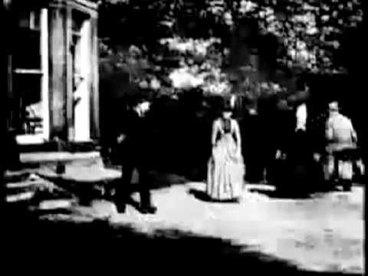
first video, Louis Le Prince, 1888

Slide 22
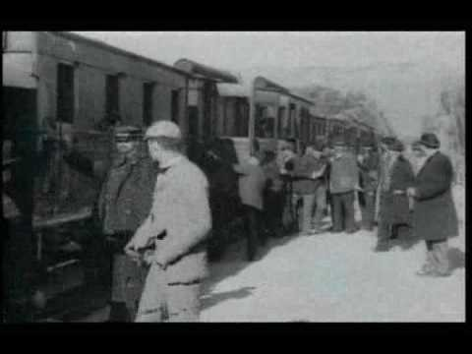
First video, Auguste and Louis Lumière, 1895
Ссылка

Slide 23
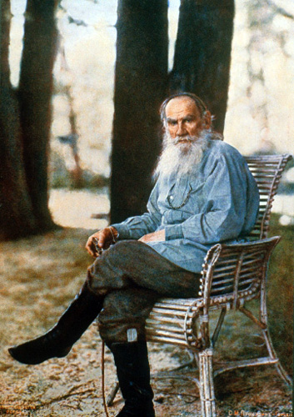
Prokudin-gorskiy, 1915
This is the photo of L.N.Tolstoy made by Prokudin-Gorskiy in 1908.
How he did that?
Ссылка

Slide 24
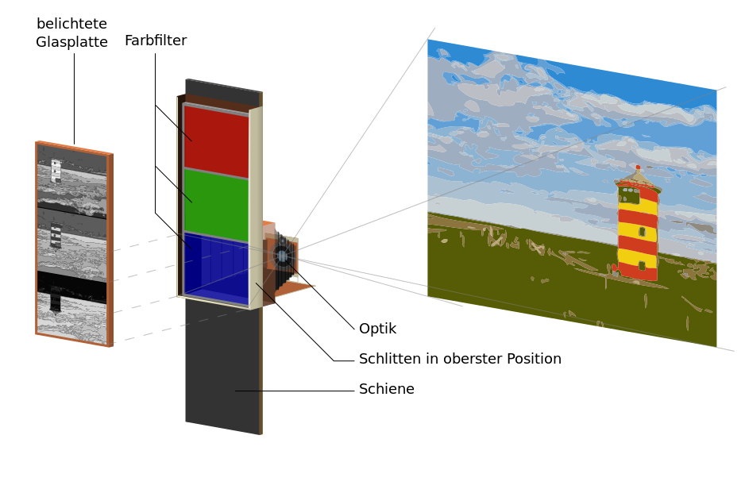
color technology
1850 – Levi Hill
1886, 1908 – Gabriel Lippman
1855 – James Maxwell
1861 – Thomas Satton
Ссылка

Slide 25
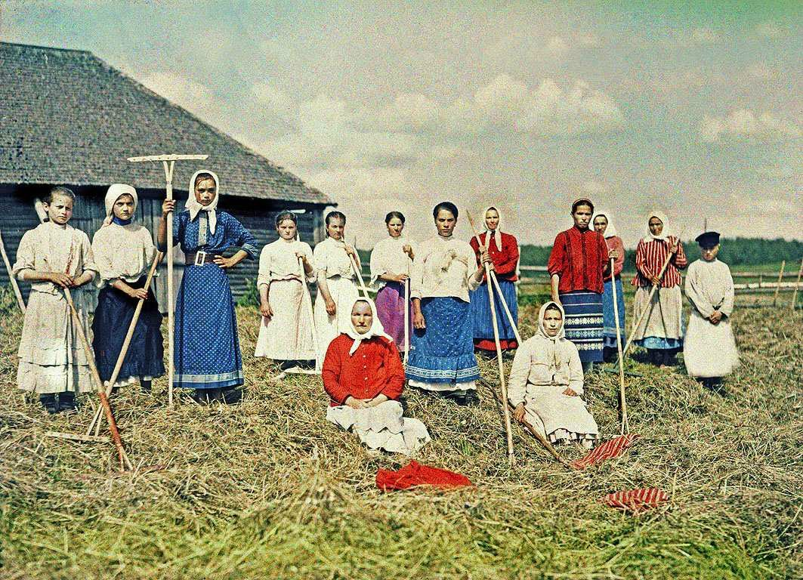
Ссылка

Slide 26
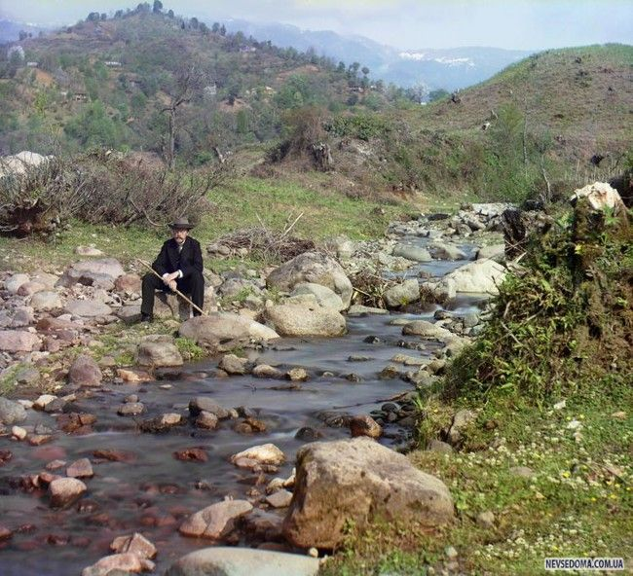
Ссылка

Slide 27

Ссылка

Slide 28
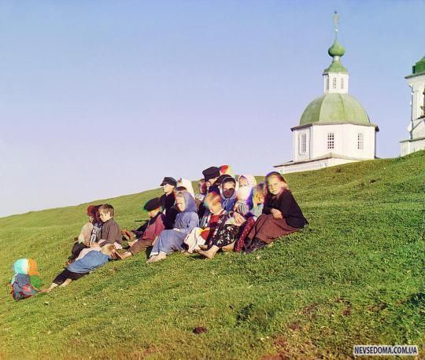
Ссылка

Slide 29
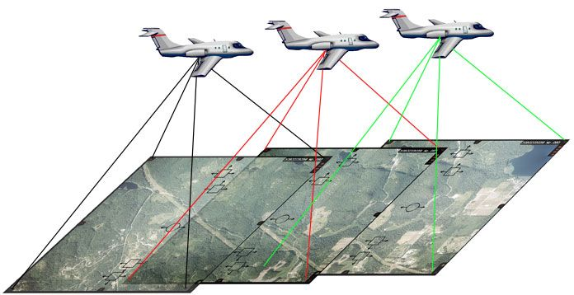
Photogrammetry, ~1850-е
Photogrammetry is the science of making measurements from photographs. The input to photogrammetry is photographs, and the output is typically a map, a drawing, a measurement, or a 3D model of some real-world object or scene.

Slide 30
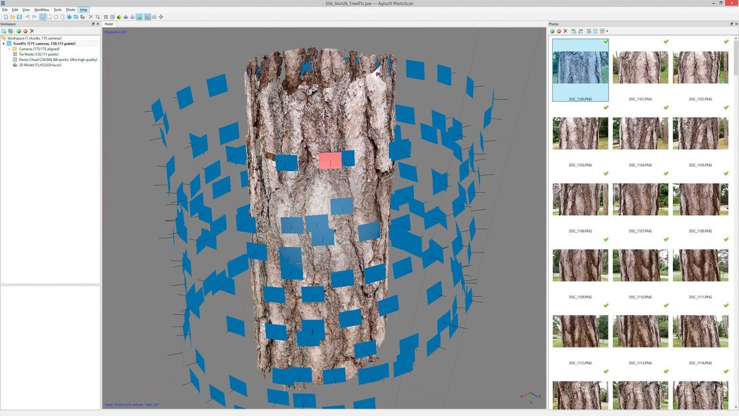
Stereo photogrammetry

Slide 31
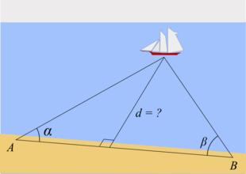
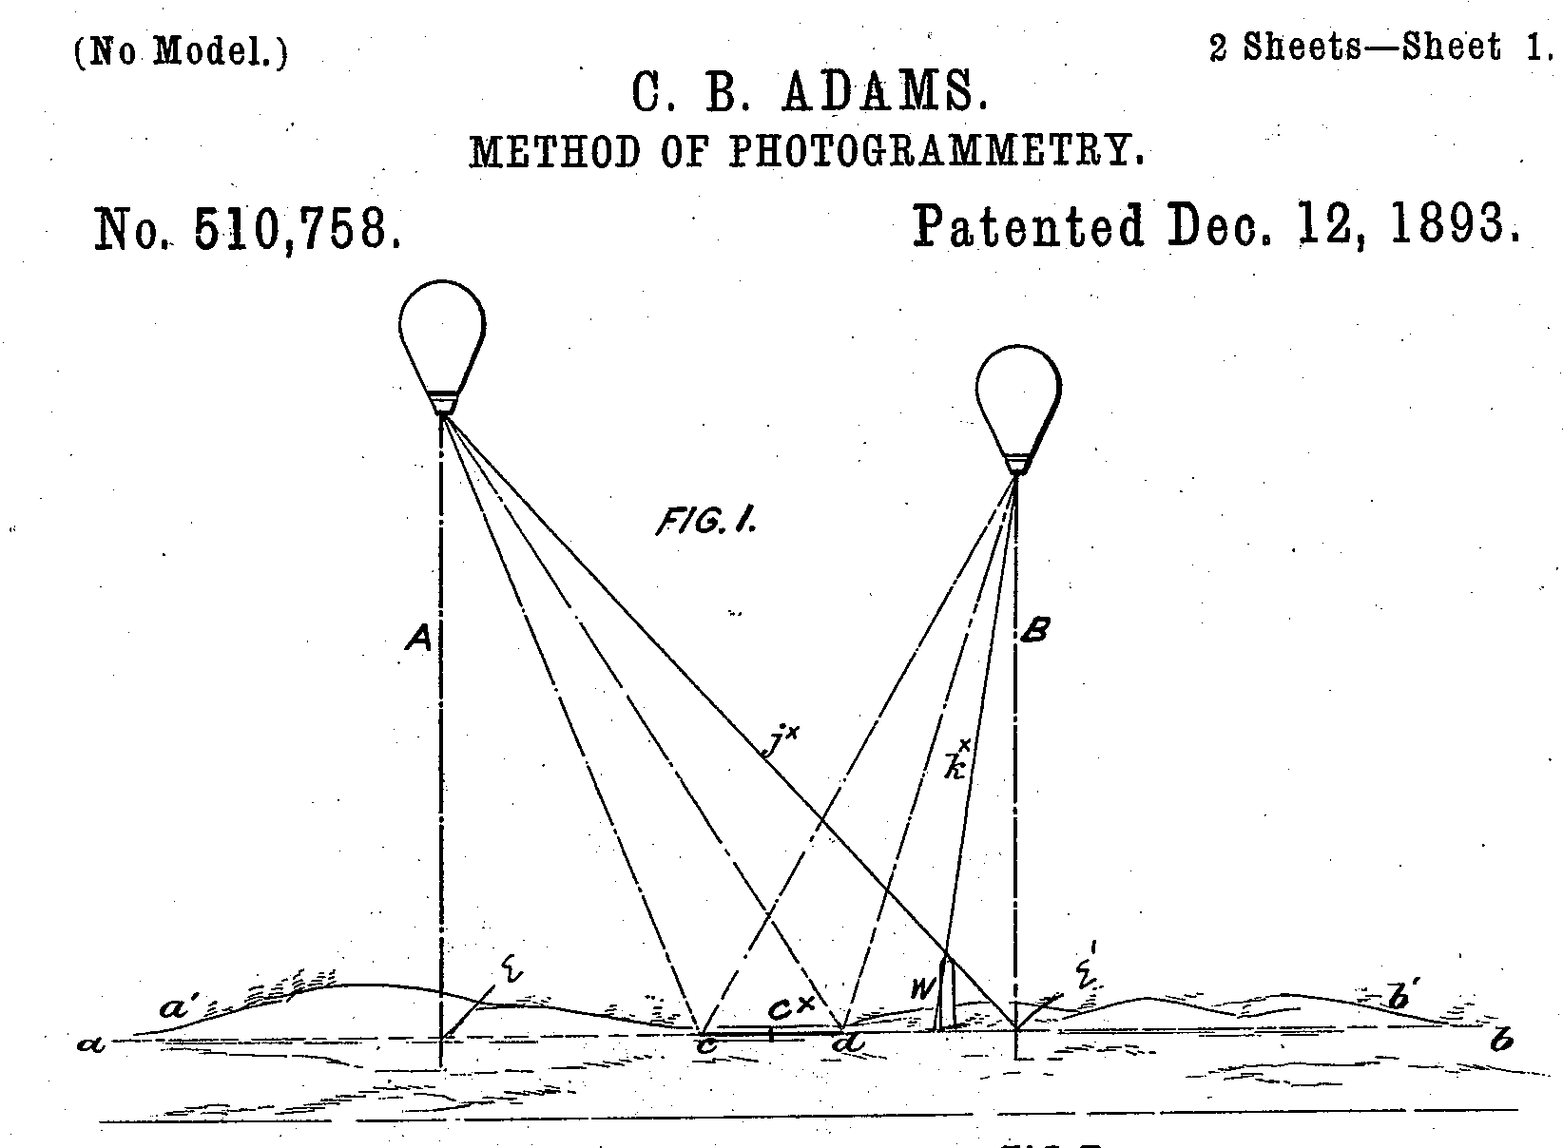
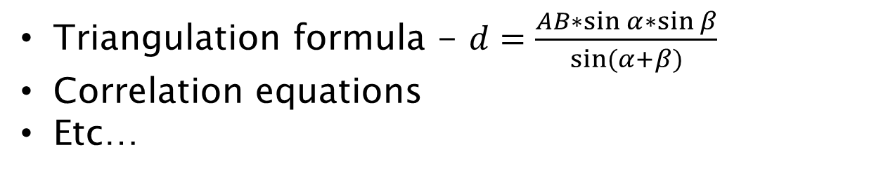
Stereo photogrammetry
Triangulation formula - $d=\frac{AB∗\sin{α}∗\sin{β}}{sin⁡(α+β)}$
Correlation equations
Etc…

Slide 32
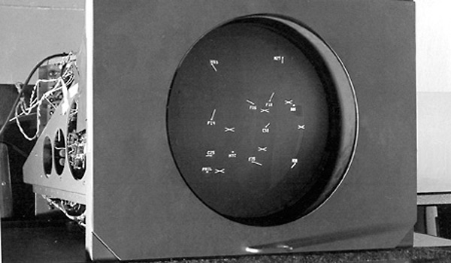
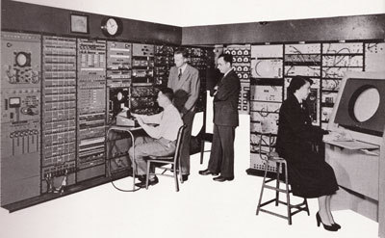
Whirlwind, 1951
Ссылка

Slide 33
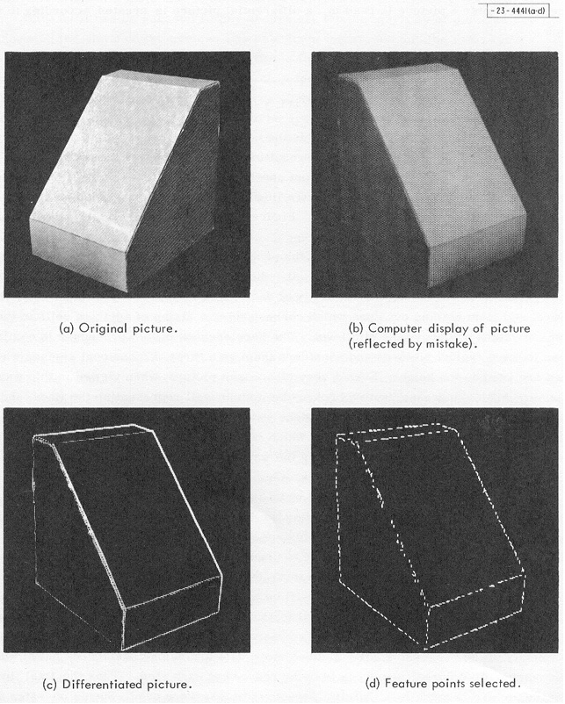
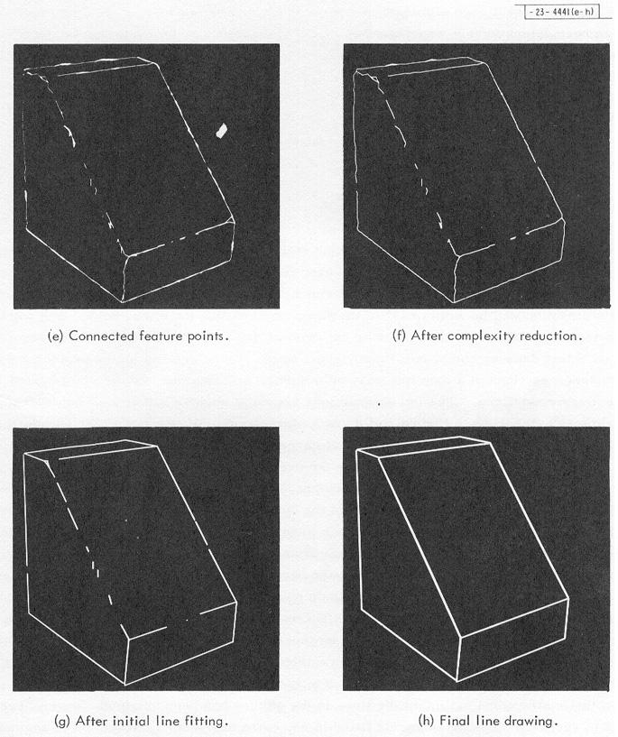
3D solids, 1963
Ссылка

Slide 34
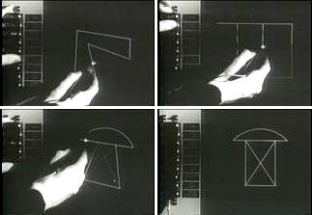
Sketchpad, 1963

Slide 35
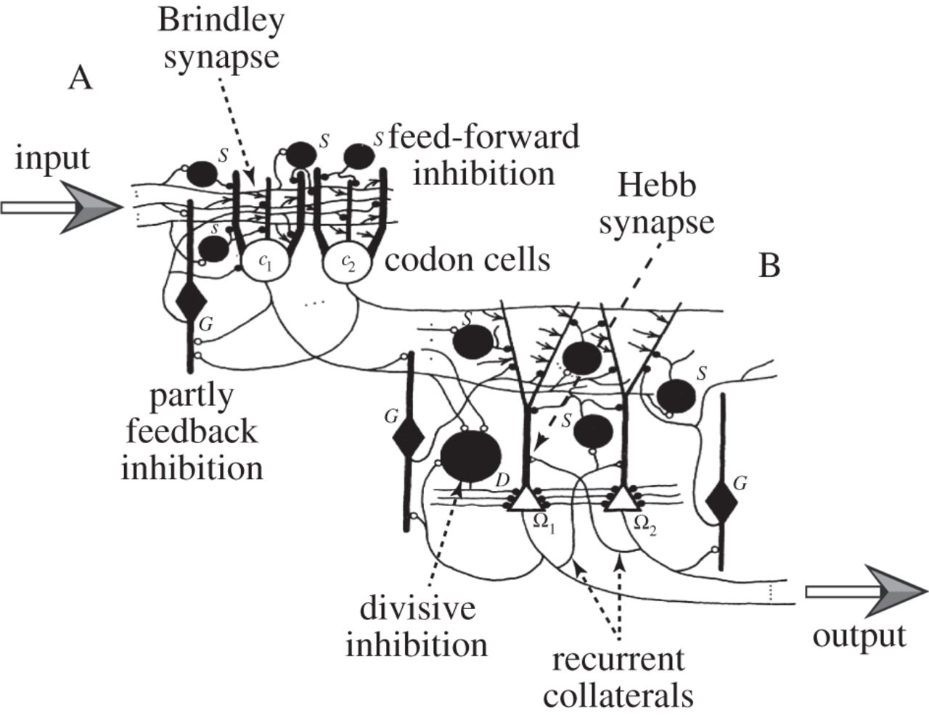
David marr, 1971
A primal sketch of the scene – fundamental shapes recognition – angles, lines, etc
a 2.5D sketch of the scene, texture recognition
a 3D model, scene visualization without gaps
Ссылка, ссылка

Slide 36
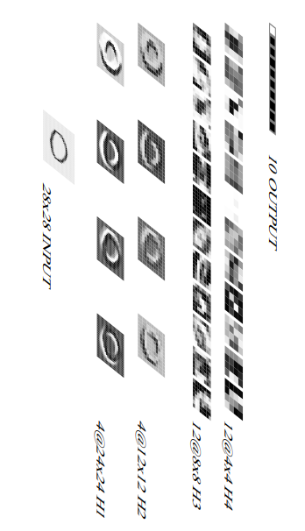
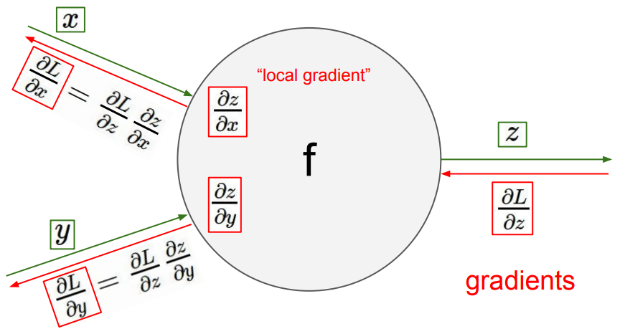

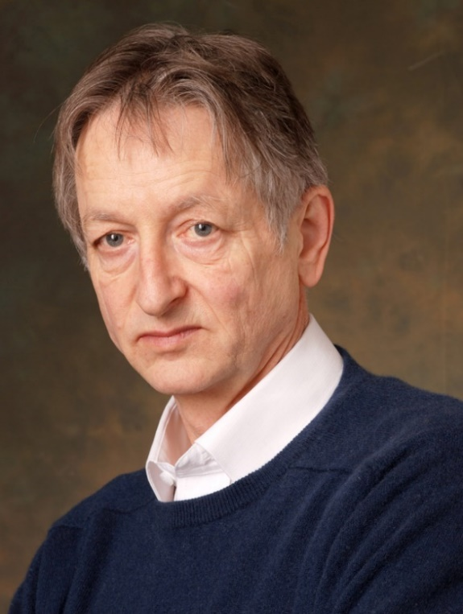
Yann lecunn, 1989
Yann LeCunn
Jeffrey Hinton

Slide 37
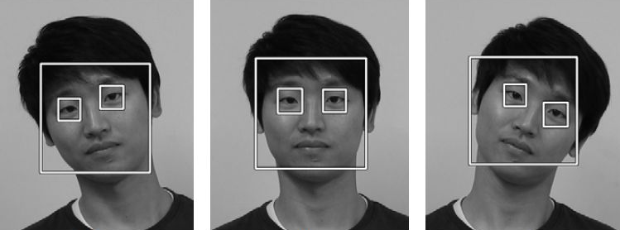
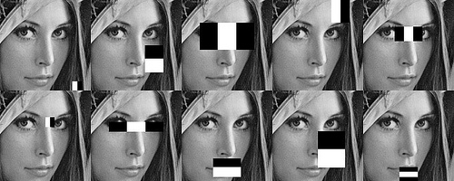
Viola-jones face detector, 2001

Slide 38
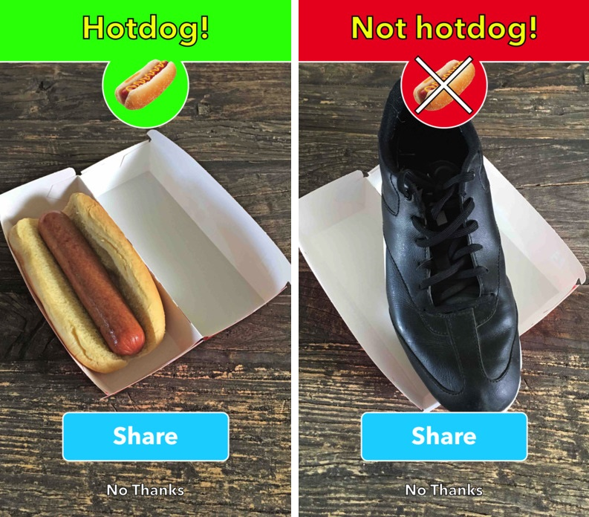
Some applications
“Silicon Valley” series

Slide 39

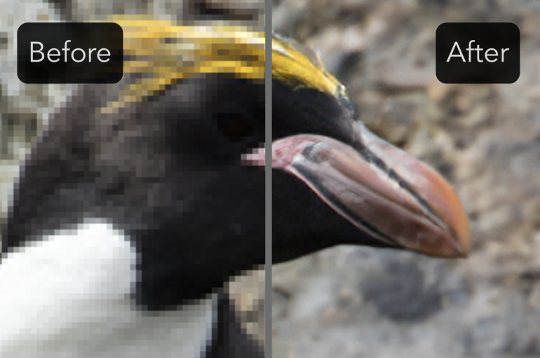
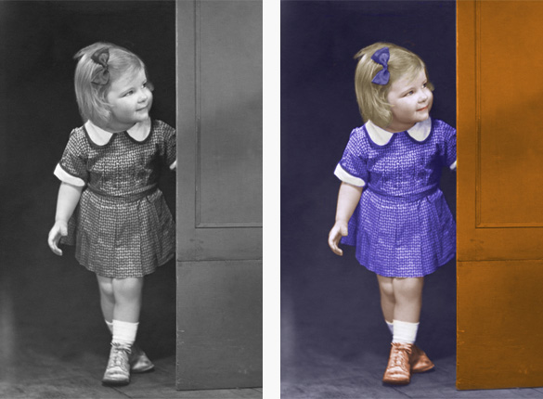
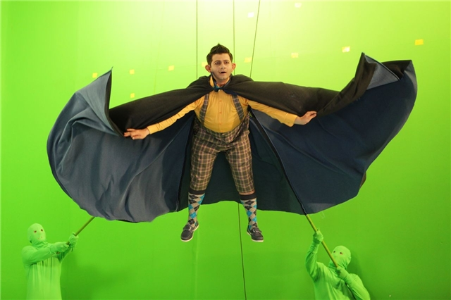
contrast, illumination
Quality enhancement
Eliminating JPEG artifacts
colorization
Creating effects

Slide 40
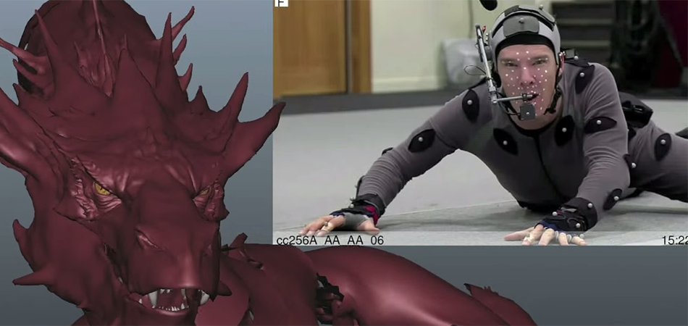
creating 3d models
The Hobbit: The Desolation of Smaug

Slide 41
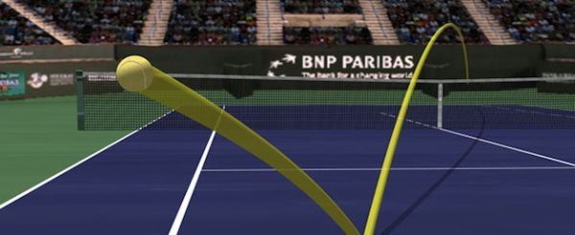
sports
Tracing ball trajectory

Slide 42
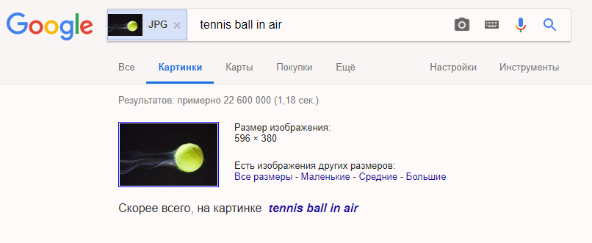
Search images

Slide 43
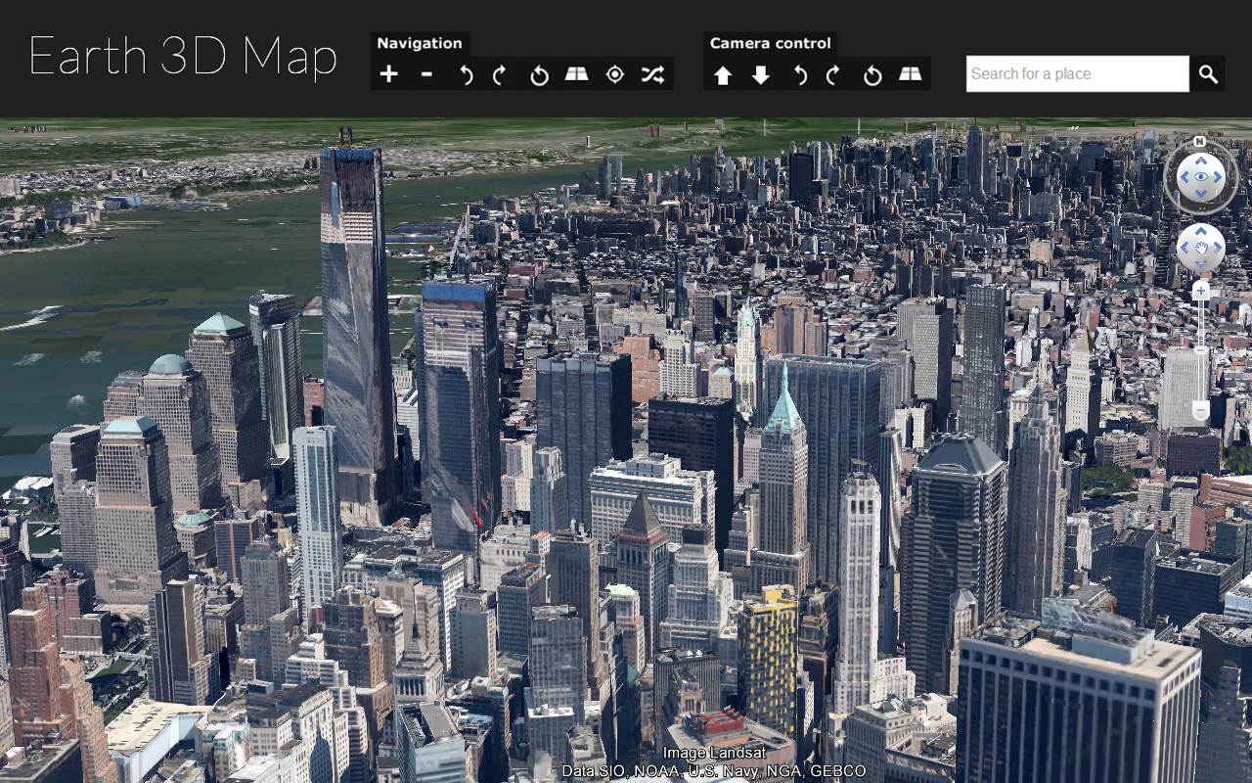
3d maps
Google Earth, 2001-2017

Slide 44
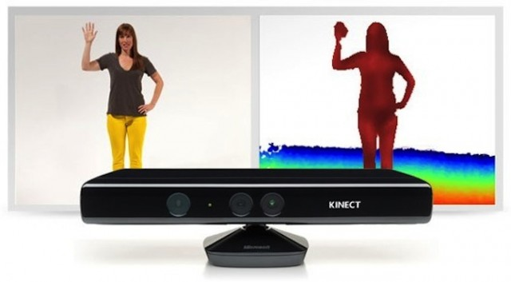
Kinect
Microsoft Kinect, 2009

Slide 45
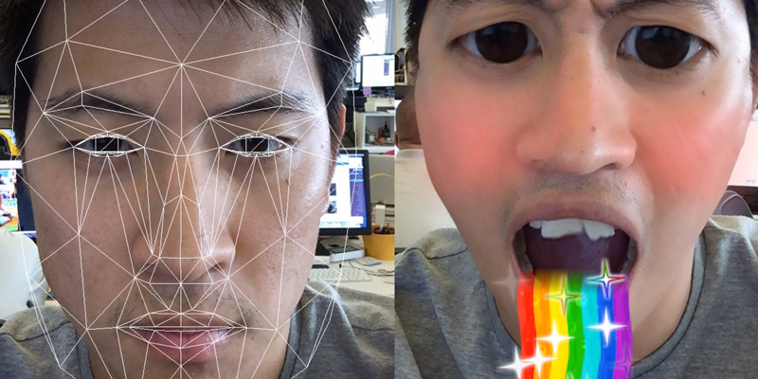
Snapchat
SnapChat, 2011

Slide 46
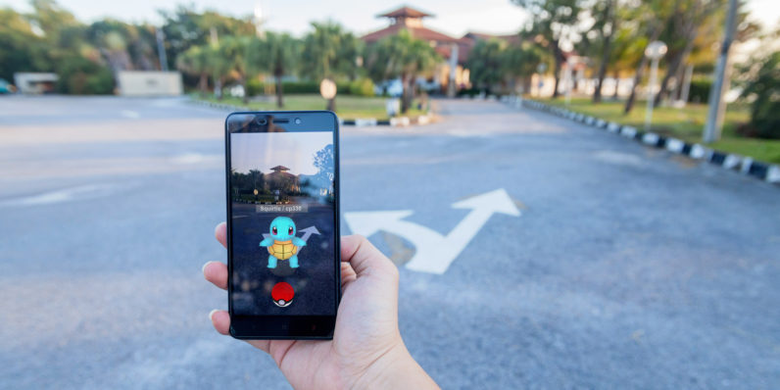
Augmented reality
Pokemon GO, 2016

Slide 47


Face id
Face ID, Apple, 2017

Slide 48

Self driving cars

Slide 49

robots
Boston Dynamics, 2018

Slide 50

One I liked ))

Slide 51


Face2face, DeepfaKe

Slide 52

Why doing cv is hard?
Angle of rotation
Scale
Illumination
Angle of photos
3D -> 2D creates ambiguity
…
More examples

Slide 53

Problems visualized
Angle

Slide 54

Problems visualized
Color

Slide 55

Problems visualized
Diversity

Slide 56

Problems visualized
Perspective

Slide 57

Problems visualized
Illumination

Slide 58

Problems visualized

Slide 59

Problems visualized
Aberrations

Slide 60

Human perception
What is on the photo?

Slide 61

Human perception
What is on the image?

Slide 62

Off top
This picture is from Playboy as of 1972
In 1973 Alexander Savchuk used it in his CV work
Lena Söderberg is on the photo
This picture has the big dynamic range – dark and bright pixels

Slide 63

Human perception
What is the color of objects on the image?

Slide 64


Basics
Light is a wave
We can see a very tiny range
What we see is reflections of the light

Slide 65


imperfection of the eye

Slide 66

human vs octopus

Slide 67

Ear vs eye

Slide 68



image
An image is an artifact that depicts visual perception, for example, a photo or a two-dimensional picture, that has a similar appearance to some subject—usually a physical object or a person, thus providing a depiction of it

Slide 69







How to get an image

Slide 70


Signal digitizing
Photosensitive elements
Spatial location is not ideal
They can break
Signal transfer is imperfect
Digitizing of space and brightness

Slide 71


Image is a matrix

Slide 72






Color channels
Mix of 3 with 33% of brightness
Result is different as Windows OS has its own mechanism of dealing with colors based on humans perception

Slide 73

color
Day light
Night
Color – subjective characteristic of the electro-magnetic optical range
Relative visibility
Wavelength, nm
Function of humans sensitivity of brightness in day/night

Slide 74


Metamers
Metamerism – different spectral characteristics can have same impact on the perception of the color
Shirts that have same color in day light are of different color when exposed to ultraviolet

Slide 75

spectrum
Different objects have different spectrum
Texture, material, etc. affect the spectrum

Slide 76

Grassman’s laws
There are 4 laws (see Wikipedia), but they basically express the idea that empirical perception of color linear.

Slide 77


Trichromatic theory
Choose 3 base colors (wavelengths)
Find codes for other colors using base experimentally

Slide 78


LMS model
Calculate the codes using this function and known illumination on an object
There are LMS variations that are not possible in nature
You cannot build a display using LMS model
Take the function of spectral response of eye cones normalized by max value

Slide 79

Cie rgb, 1931
R = 645.2 nm
G = 525.3 nm
B = 444.4 nm
Can we code every color using that model?

Slide 80

Color matching function

Slide 81

Color gamut
Color gamut illustrates the visible spectrum and spectrum that can be coded in different color models

Slide 82

HSV model
RGB model does not have brightness
So when the color TV appeared someone solved that problem by introducing HSV model
Hue, Saturation, Brightness

Slide 83

Conversion from RGB to HSV

Slide 84

Cmyk subtractive model
Useful in print

